Slide 1
Discussion of PDDI CDS IG HL7 Workgroup Meeting
http://hl7.org/fhir/uv/pddi/2020SEP/index.html

Slide 2
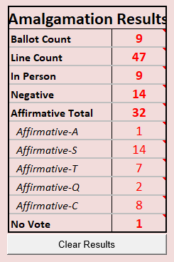
Ballot Results

Slide 3
Concerns
In patient and outpatient in scope? (26)
If so, how related to NCPDP SCRIPT? (31, 33)
Security (39,40)
configuration based hook coordination
Reference to base specification of CDS Hooks not acceptable (4 – 8, 16)
Base specification redundant with CDS Hooks (5)
Filtering could lead to complacency (35)
Ensure clinicians are aware and involved in filtering decisions (36)

Slide 4
Concerns continued
Include other types of drug interactions? (2)
Dietary supplements, natural products, vitamins etc.
The need to two CDS at different points in the workflow
Better to alert at a later stage than order-select but before order-sign (34)
Numerous wording suggestions and small enhancements
(after ballot) DetectedIssue and its use

